Slide 1

TOXICITY DETECTION AND ANALYSIS IN SOCIAL MEDIA
VINAY PANDEY - SEC A - ROLL NO. 71
UNIVERSITY ROLL NO. 2019229
MENTOR - DR. ASHWINI KUMAR SINGH , PROFESSOR

Slide 2
INTRODUCTION
Misinformation appears in a variety of ways, such made-up news, altered pictures, or false statements. Because of its quick sharing capabilities, social media is a perfect environment for spreading false information because viral content may quickly reach millions of people. This presents serious problems.
Beyond the negative effects on one's physical and mental health, toxic behavior also undermines the integrity of online communities. Toxic conduct must be identified and addressed in order to provide a healthy digital environment.We can all work to lessen the negative impacts of toxic conduct on social media by encouraging empathy, respect, and digital literacy.
Actions ranging from disseminating misleading information, hate speech, and trolling online to cyberbullying and harassment are all considered forms of toxic behavior. It frequently flourishes on the anonymity and distance that come with online connections, enabling people to indulge in activities they might not do in person

Slide 3
Our project's goal is to provide a thorough toxicity analysis system for social networking sites. Our goal is to develop a powerful tool that can detect and evaluate hazardous content using cutting-edge natural language processing and machine learning approaches, in light of the widespread problem of harmful conduct online.In this project, we will be utilizing a machine learning model, based on bidirectional Long Short Term Memory from the tensorflow library.
Our dataset has been taken from kaggle which includes train and test splits with various parameters of toxicity like hate , racism, slur, severity etc.All of this data has been classified using the NLP technique of vectorisation which transforms them into numeric tokens which can be fed to a dense Neural Network with a bidirectional LSTM layer to read the text through and through both backward and forward.

Slide 4
METHODOLOGY
PYTHON
JUPYTER NOTEBOOK
PANDAS
TOOLS AND TECHNOLOGIES USED
TENSOR
FLOW
KERAS
NUMPY

Slide 5
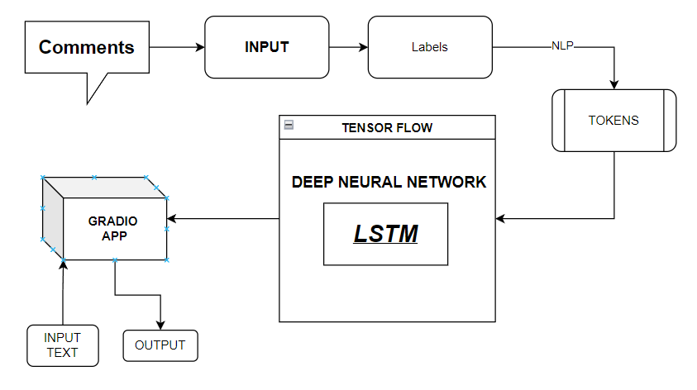
PROPOSED WORKFLOW
The system presented here composes of six modules:-
1. Input as Dataset
2. Pre-processing
3. Data Labeling (Conversion to 0 to 1 float value)
4. Tokenize the text using built in Functions
5. Build & Model train a Deep Neural Network based on BiDirectional LSTM
6. Take Input from gradio app and Output as Predicted Result

Slide 6
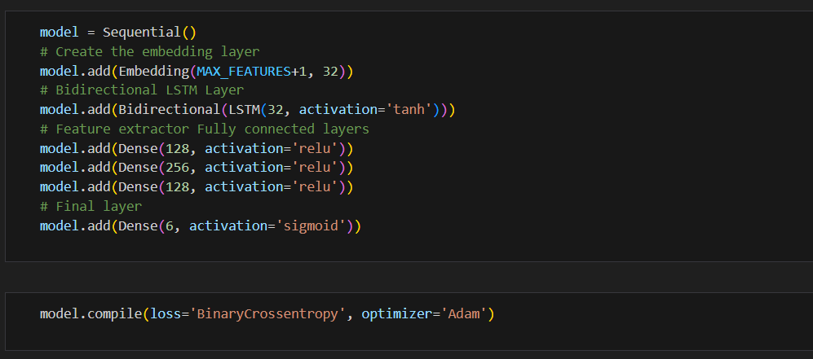
Data of the Toxic Comments and Labels have been taken from a website named Kaggle[6]. The data is then cleaned, scaled accordingly, and then split into values with range between 0 and 1, including float values which is then tokenized to be used in the model,values are then used to train our BiDirectional LSTM Model.
The above figure shows the code for the Bi-Directional LSTM model with Deep Neural Network with a 93% accuracy on test data. This model will be built into a Gradio application for easier use with new data.

Slide 7
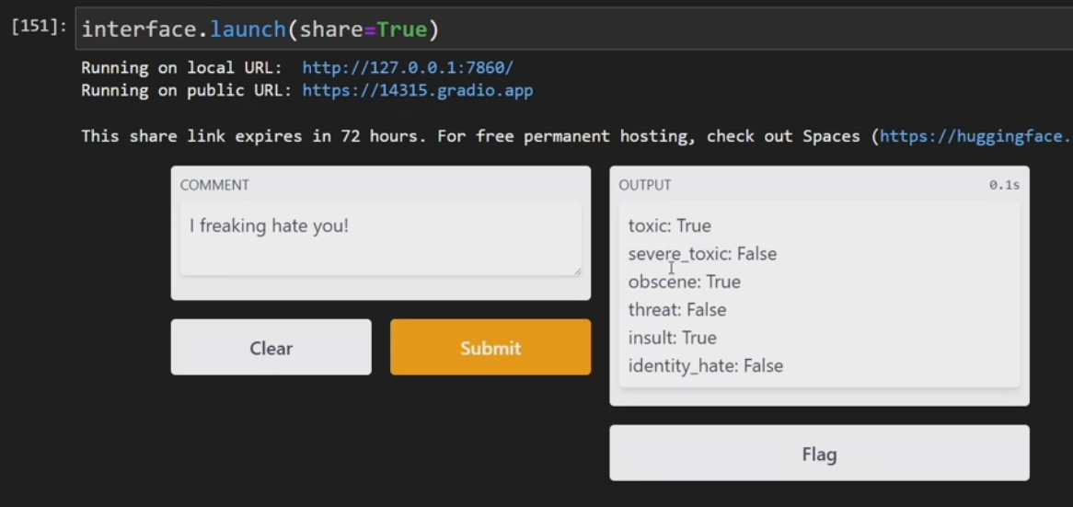
RESULT AND DISCUSSION
By following the described methodology, a TensorFlow Text Vectorizer was used to extract word weight using Natural Language Processing (NLP) whose output was used to train a Bi-directional Long Short Term Memory based Deep Neural Network which can tell with a good accuracy about whether a particular post is toxic or not and on what parameters. Since we used a bi directional model we were able to accurately study the given text Utilizing this model for testing on one case is given below
IMPLEMENTATION AND RESULT OF TOXICITY ANALYSIS FUNCTION USING GRADIO

Slide 8
Although numerous machine learning models like BERT with higher accuracy are available, this model can be further enhanced by giving it a proper graphical interface, as well as training it with increased parameters like origin of post, context info, metadata, associated posts and groups. A better GUI could also be made with lightweight frameworks like Flask or Django which could make it easier to use. An API for easy integration into apps could also be made to benefit the user and make it easier for developers to integrate this system into their applications.

Slide 9
CONCLUSION AND FUTURE WORK
Through this project, I have developed a system that can predict if a social media post is likely to be toxic or not, and on various grounds of toxicity, fairly accurately based solely on the content information . It has the potential to be applied to various post sentiment and social media platforms to ensure that the user generated content is not hateful or toxic towards any race, ethnic backgrounds or groups.
However it is important to note that the model , though provides a good accuracy over the original dataset, is still not a totally accurate analysis of the independent posts and needs more data to be trained on with several more parameters. A button or option to report false claims should be recommended with a deployment of this model.
Moreover, there are a number of intriguing directions to pursue for the project's future development. Toxicological identification is a persistent difficulty due to the dynamic nature of online communication and the constantly changing social media ecosystem.

Slide 10
THANK YOU

